Slide 1
WIRELESS EMBEDDED SYSTEM Hardware Basis for IoT
Doan Duy, Ph. D.
Email: duyd@uit.edu.vn

Slide 2
Content
Sensors for IoT design
Analog-to-Digital Conversion
Microcontroller and Hardware Module
IoT Gateway

Slide 3
Structure of IoT network/system

Slide 4
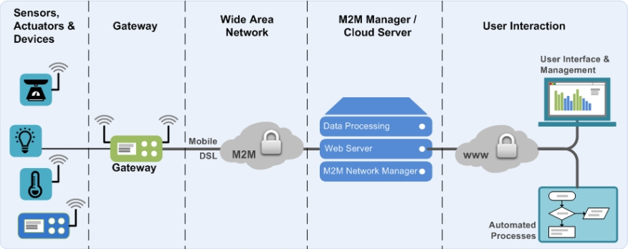
IoT Portion – Tier 1&2

Slide 5
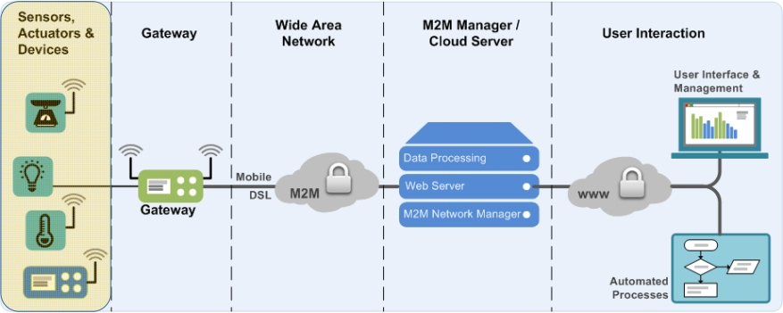

Slide 6
Sensors
An electronic component
Detects events or changes in its environment
Send the information to a computer processor
A sensor vs one property
It be sensitive to the measured property and insensitive to any other property.
Analog Sensors
Analog-to-Digital Conversion
Signal Processing

Slide 7





Processing Data
Environment
Computer collect/receive data from a set of sensors
Computer Interface’s Components
• Sensors to measure continuous and discrete process variables
Continuous and Discrete
Variables
• Devices for ADC
ADC
Computer
Controller
Input Devices

Slide 8
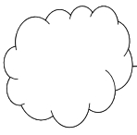
Sensors
Stimulus (s) Signal (S)
Physical
Sensing
Element
Target
Handling
Conditioning
Medium
Temperature
Resistance
Voltage
Information

Slide 9



Sensors
A sensor is a transducer that converts a physical stimulus from one form into a more useful form to measure the stimulus
• Analog
• Discrete
• Binary
• Digital (e.g., pulse counter)
Ultrasonic
(distance)
Light
(light intensity)
Touch

Slide 10
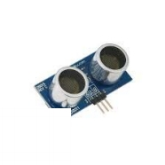
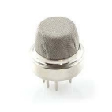
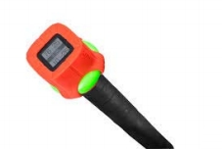
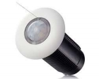
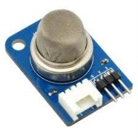
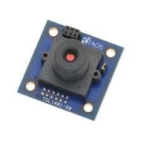
Sensors-Example
• Temperature
• RFID
• Barcode
• Proximity
• Vision
• Gyroscope
• Compass
• Tilt/Acceleration

Slide 11
Transfer Function
The sensed event activates/influences electric circuit and current/voltage
The sensitivity is the ratio between the output signal and measured property.
The output signal is measured using a transfer function, which determine the relation between the stimulus and the output signal
S = f (s)

Slide 12
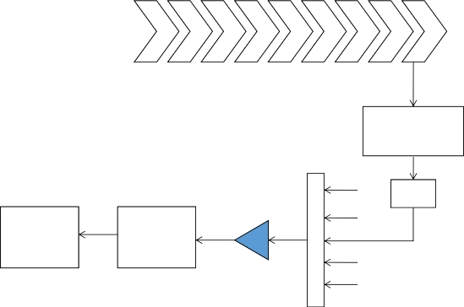
Analog-to-Digital Conversion
Transformation Process
Continuous
Variable
Sensors
& Transducer
Multiplexer
Amplifer
Signal
Digital
Computer
Analog
Digital
Conditioner
Converter
Other Signals

Slide 13
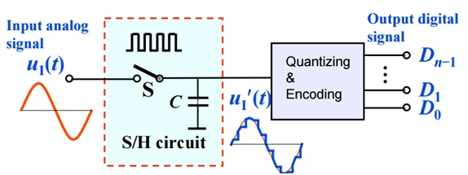
Analog-to-Digital Conversion (cont.)

Slide 14
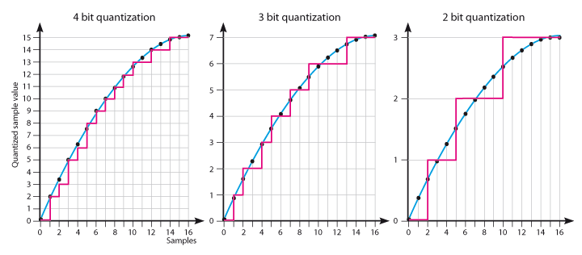
Analog-to-Digital Conversion (cont.)
Sampling rate – rate at which continuous analog signal is polled e.g. 1000 samples/sec
Quantization – divide analog signal into discrete levels
Resolution – depends on number of quantization levels

Slide 15
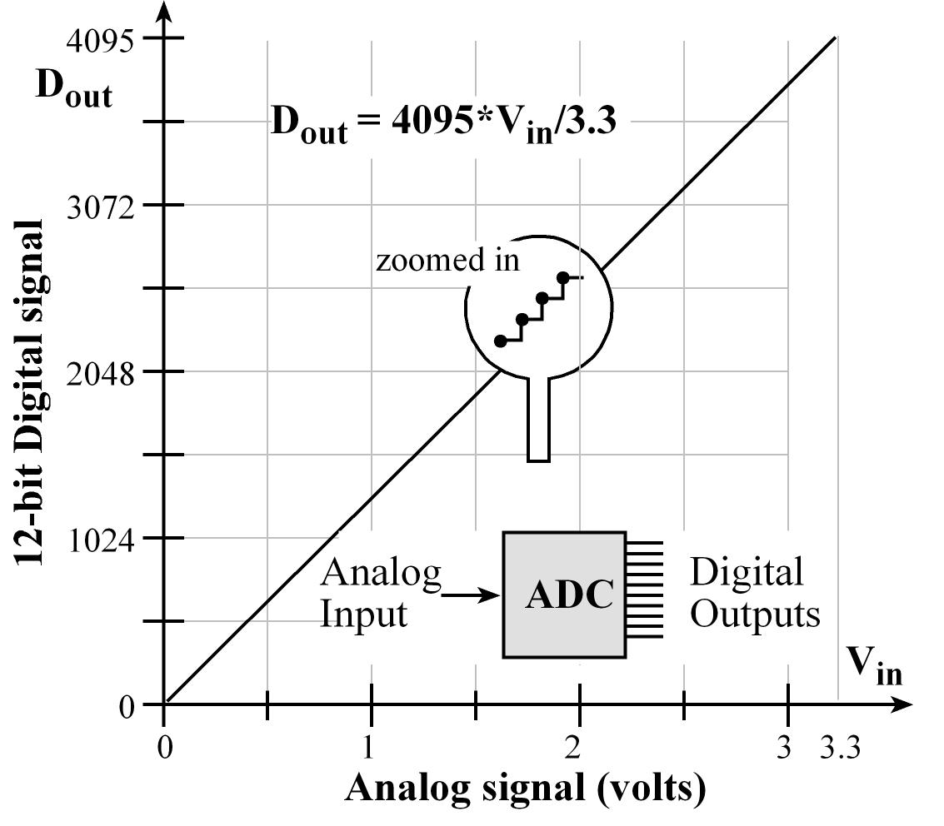
Analog-to-Digital Conversion (cont.)
Conversion time – how long it takes to convert the sampled signal to digital code
Conversion method – means by which analog signal is encoded into digital equivalent

Slide 16
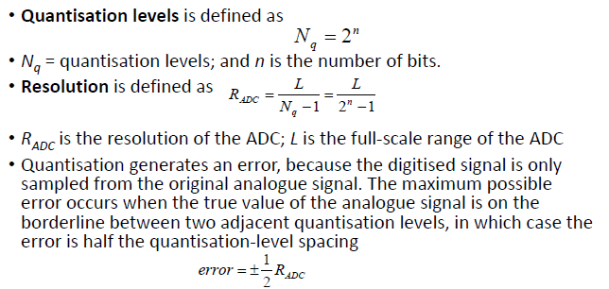
Sampling

Slide 17

Open Hardware Source
Following the open source software, open‐source hardware was driven by the open course culture movement.
The hardware is easily discerned to allow others to make it.
Hardware design are released under free/libre terms.
• Mechanical drawings
• Schematics
• PCB layout data
• HDL source code
• Low level software (drivers)
• Integrated circuit layout data

Slide 18
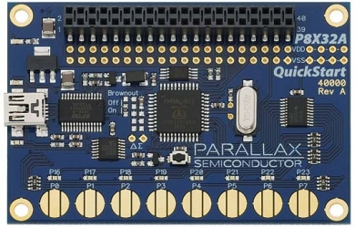
Microcontrollers
Small computer on a single integrated circuit.
A self‐contained system with a processor, memory, and peripherals.
Usually used in automatically controlled products and devices
Programmable devices
Parallax Propeller P8X32A Microcontroller
Not easy to teach and use

Slide 19
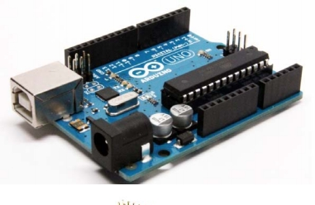
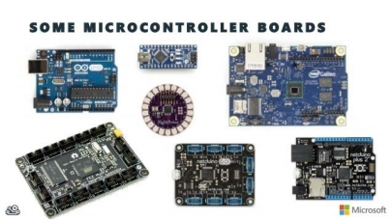
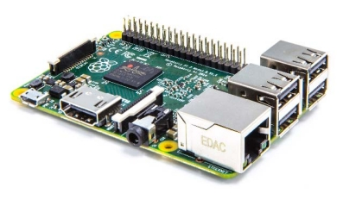
Modern Hardware Devices
Open Hardware
Easy to use and program
Easy to connect to other devices
• Arduino
• Raspberry PI

Slide 20

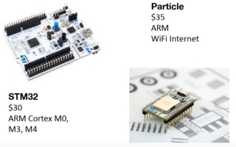
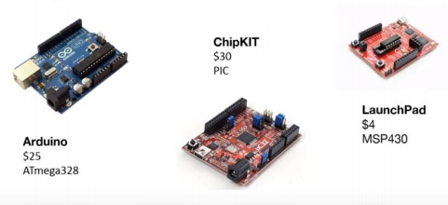
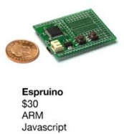
Microcontroller Boards

Slide 21
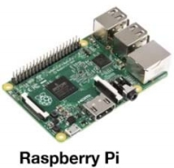
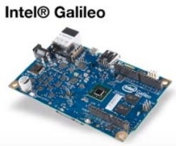
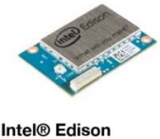
Sensor Processing and Network
Raspberry PI
• ARM
• GPU
• 1GB RAM
Intel Galileo
• Quark x86
• 256 MB RAM
Intel Edison
• Core Atom
• 1 GB RAM
• WiFi
• Flash Memory

Slide 22
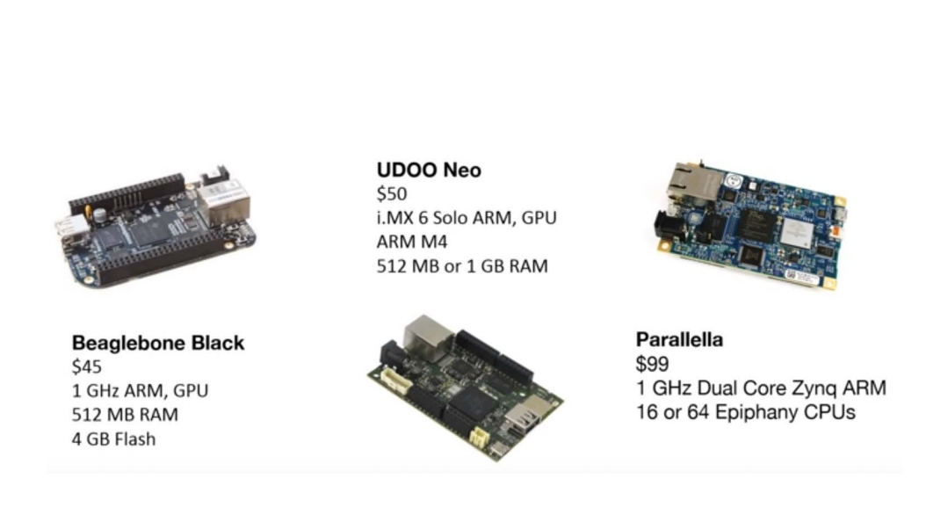
Sensor Processing and Network (cont.)

Slide 23
Further Reading – IoT Hardware Guide
• Find the right IoT development hardware for your product or DIY project needs. Compare leading boards/kits and get reviews and pricing info.
https://www.postscapes.com/internet‐of‐things‐hardware/

Slide 24
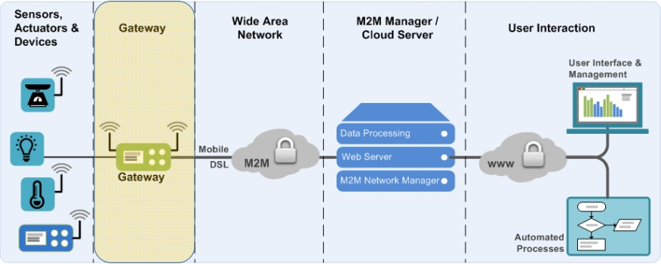
IoT Portion

Slide 25
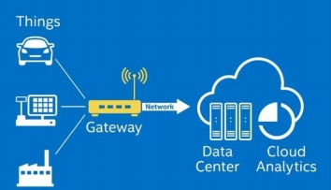
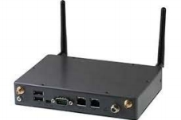
IoT Gateway/Edge Gateway
IOT gateway sets on the communication between IoT devices, sensors, equipment, systems and the cloud.
Practically, it connects the field and the cloud.
It usually offer local processing and storage solutions.
It also have the ability to autonomously control field devices based on data input by sensors.

Slide 26
IoT Gateway/Edge Gateway
The need of the fields pushes to continuously increate the number of sensors. However, most of them can not communicate directly with systems.
Many sensors are energy sensitive and don’t support energy‐intensive protocols like Wi‐Fi or Bluetooth.
The generated data may include invaluable in its raw form, which can be filtered out locally.
The data of some devices could be aggregated locally to save bandwidth.
The devices are connecting to a variety of public and private networks, and often the data should be protected.

Slide 27
IoT Gateway – Functionality
An IoT gateway performs several critical functions
• Translating protocols
• Encrypting data
• Aggregating and filtering data.
• Processing and managing data.
To support these functions, it also needs local storage.

Slide 29
IoT Gateway – Important Tasks
IoT gateways can perform a important tasks
• High Scalability – receive intelligent data from the datacenter or cloud and push into the field or network edge.
• Lowering Costs – sensor/edge devices doesn’t have high processing power, memory or storage, the gateway does it for them.
• Faster Production – an accelerated and more advanced production line can decrease time‐to‐market significantly.
• Reduce Telecommunications Cost – less M2M communication means a smaller network and (WAN) traffic.
• Mitigate Risks – gateways can isolate defected devices and sensors before they cause damage or problems.

Slide 30
IoT Gateway – Security Layer
Increase of the number of edge devices.
A combination of public and private networks.
Prevent any data tampering or unrestricted access.
Device ID (e.g. MAC addres) enables defining and managing device certificates, but to encrypt the data between the device and the cloud is impossible with the IOT gateway.
Mediate the on‐boarding of devices.

Slide 31
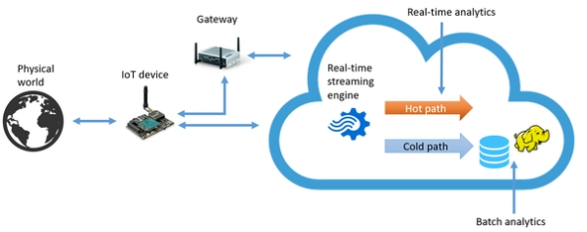
IoT Gateway – Real-Time
IoT gateways can also address the actuators
• The IOT‐gateway receives data from the sensors (field) and based on that it can also activate actuators.
• The response of gateway could you generated based on local knowledge, or received from the cloud.

Slide 32
IoT Gateway – Properties
• Network Security –providing strong security to the communicating channels and support encryption of the transmitted data.
• Downtime –functioning properly when there is no internet connection, e.g. caching and queuing data
• Connectivity – The field may have low network speed, or it may be charged based on the amount of data sent to thee cloud. You need to look for a support of appropriate protocols; e.g. CoAP and MQTT.
• Remote update – An appropriate OS
• Power – Survive power fluctuation or shortage, its should also be able to restore itself.

Slide 33

Q&A

